Slide 1
J - COMPONENT PROJECT
COFFEE STORE WEBAPPLICATION

Slide 2
TEAM - 29
2003A51013 - Rimsha Mujeeb
2003A51019 - Finza Tazeen
2103A51L31 - Rikkula Rajkumar GUIDED BY : K. RAVI CHYTHANYA SIR.

Slide 3
TOPICS | SLIDE NO:
1.ABSTRACT | 04
2.WEB SITE HOME PAGE | 05
3.DESCRIPTION | 06
4.MENUS .ABOUTS .REVIEW .PHOTOS | 07 TO 08 09 TO10 11 TO 12 13
5.COFFEE | 14 TO 16
6.COFFEE STORE | 17 TO 18
7.REQUIRMENTS | 19

Slide 4
ABSTRACT
Our application is to help a coffee store (café)
owners develop a professional website for marketing and easy management . The web application is simple and easy to navigate thus User Friendly . It also has café’s menu,review section and an optional online reservation option to help customers reserve their table in advance

Slide 5
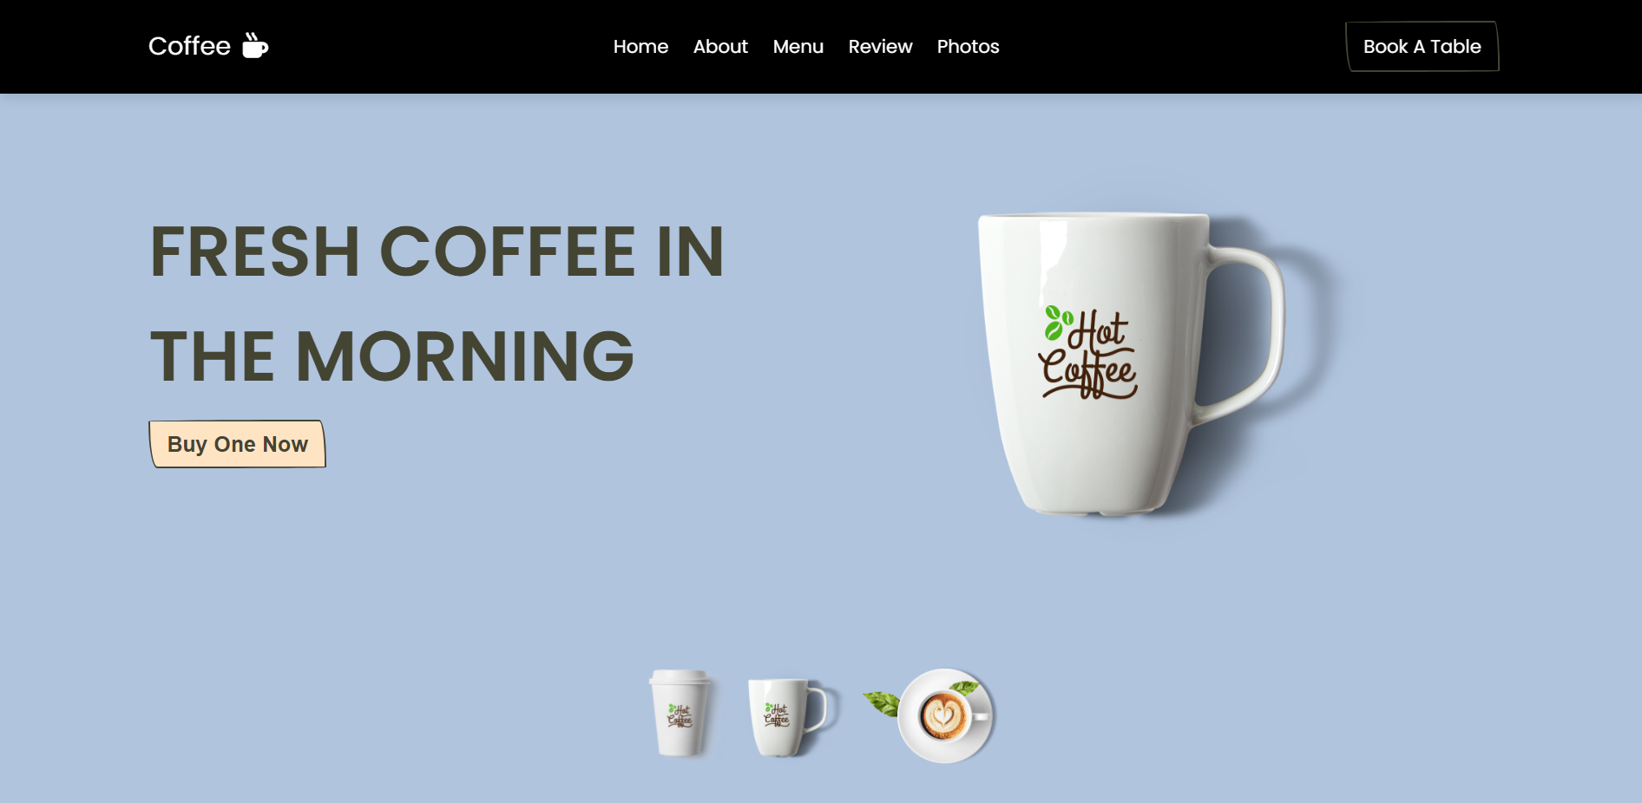
Website Homepage:

Slide 6
DESCRIPTION:
Our web application has a simple ,seamless and user friendly design . Some of the features of this website include : 1 . A MENU that is easy to follow \ Navigate. 2 . A Consumer Reviews Section on the café drinks. 3 . An Option for consumers to book \ reserve their Table .

Slide 7
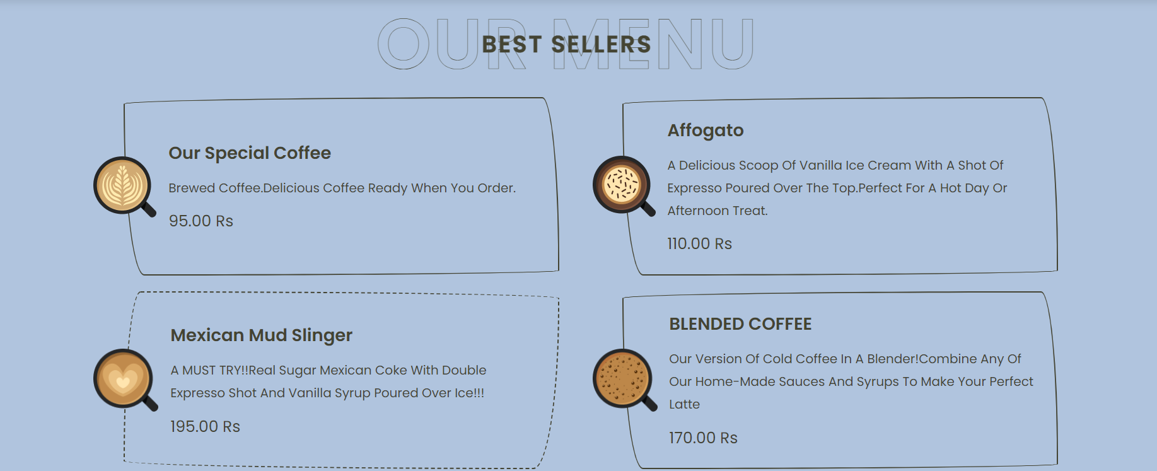
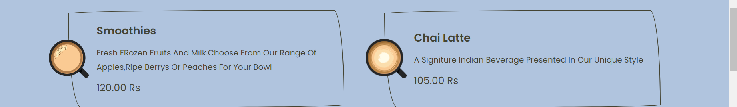
menus

Slide 8
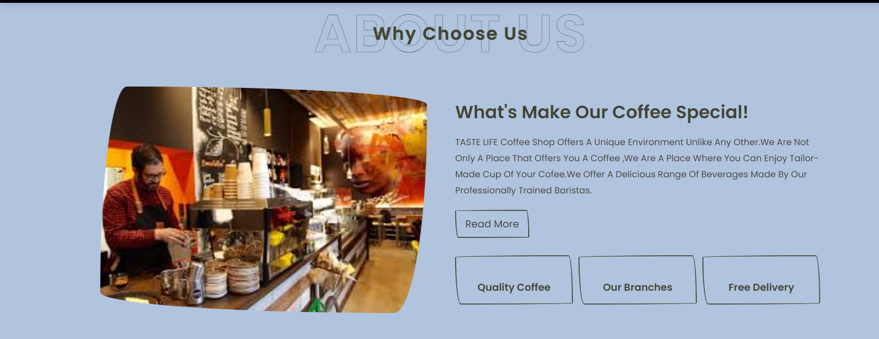

Slide 9
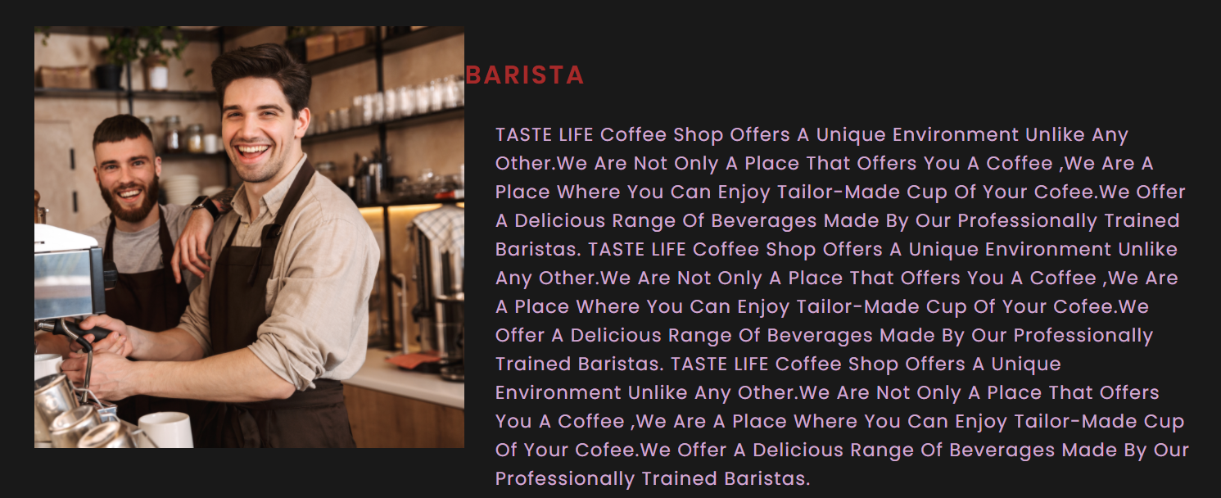

Slide 10
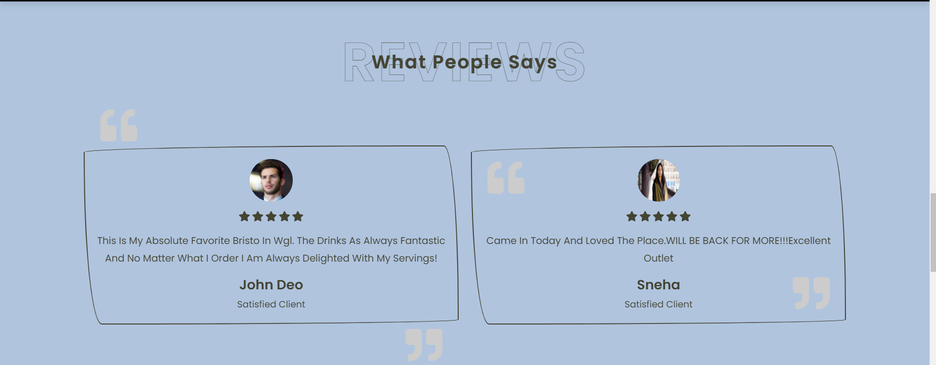

Slide 11


Slide 12
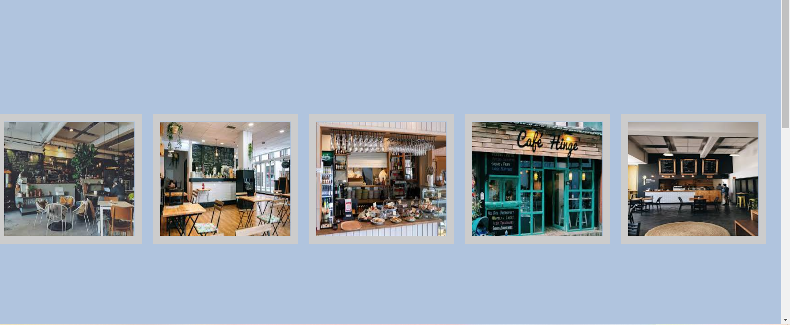
PHOTOS:

Slide 13
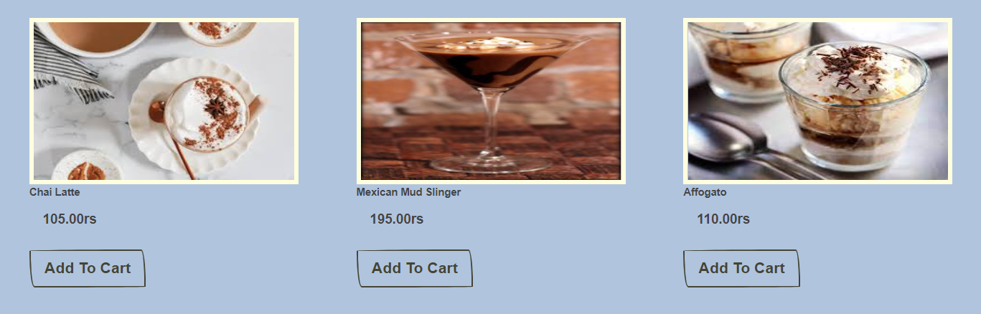
COFFEE:

Slide 14
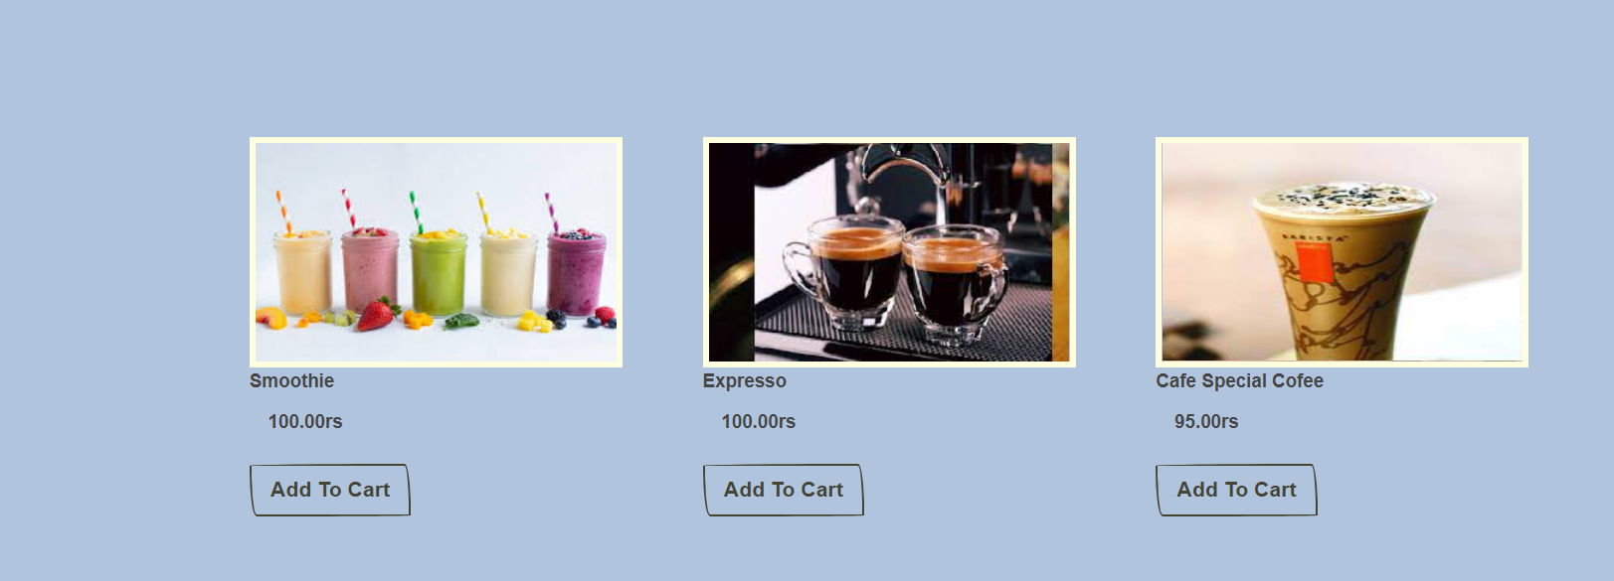

Slide 15
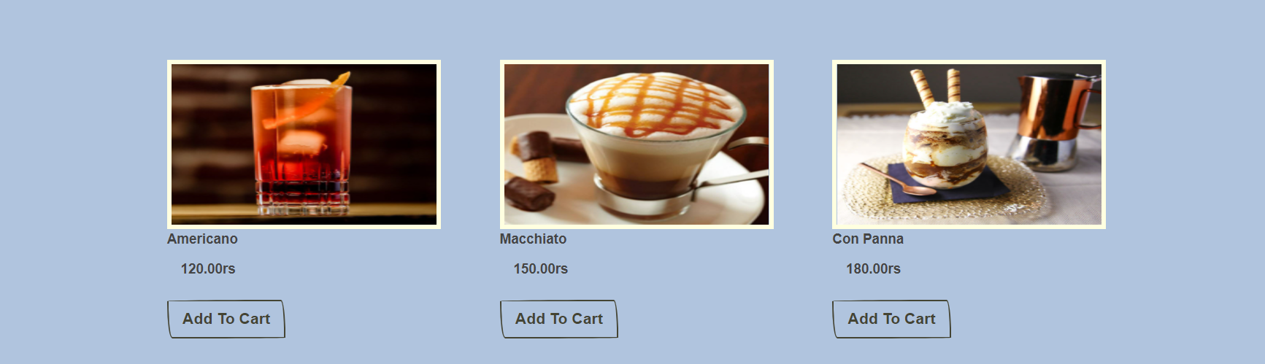

Slide 16
COFFEE STORE:
To impress visitors with your coffee shop website, adding a handful of your best-selling items and some high-resolution photos to it will never fail. Couvee is a great example of distinct coffee shop websites. The hero scene has a cool zoom-out effect as the user scrolls down the homepage. In addition, other website elements also manifest eye-catching animations. Since the navigation needs to be accessible, Couvee ensures that all other pages can be accessed with ease using an off-canvas menu and sticky header.Moreover, it also allows users to shop for different products available in the store with ease. What’s more? The Instagram feed and the promo section also looks superb.

Slide 17
REQUIREMENTS:
Café’s contact information.
Location of the place.
Café’s menu.
An honest Review section for users.
closing and opening timings of store.

Slide 18
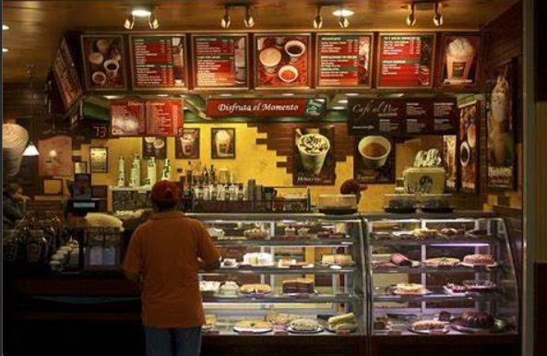
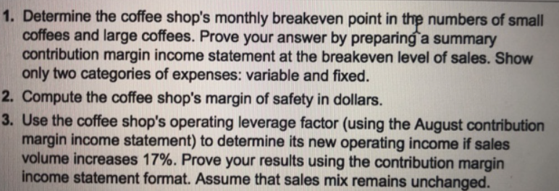
REQUIREMENTS:

Slide 19
THANK YOU

